Slide 1
Assignment 2 - KNN Classification
Professor: Maryam Ravan
Group - 5:
Furqaan Khan - 1319172
Vered Raz - 1316418
Prachiti Bahaduri - 1317686
Harsh Dalwadi - 1309370
Himani Parikh - 1322085

Slide 2
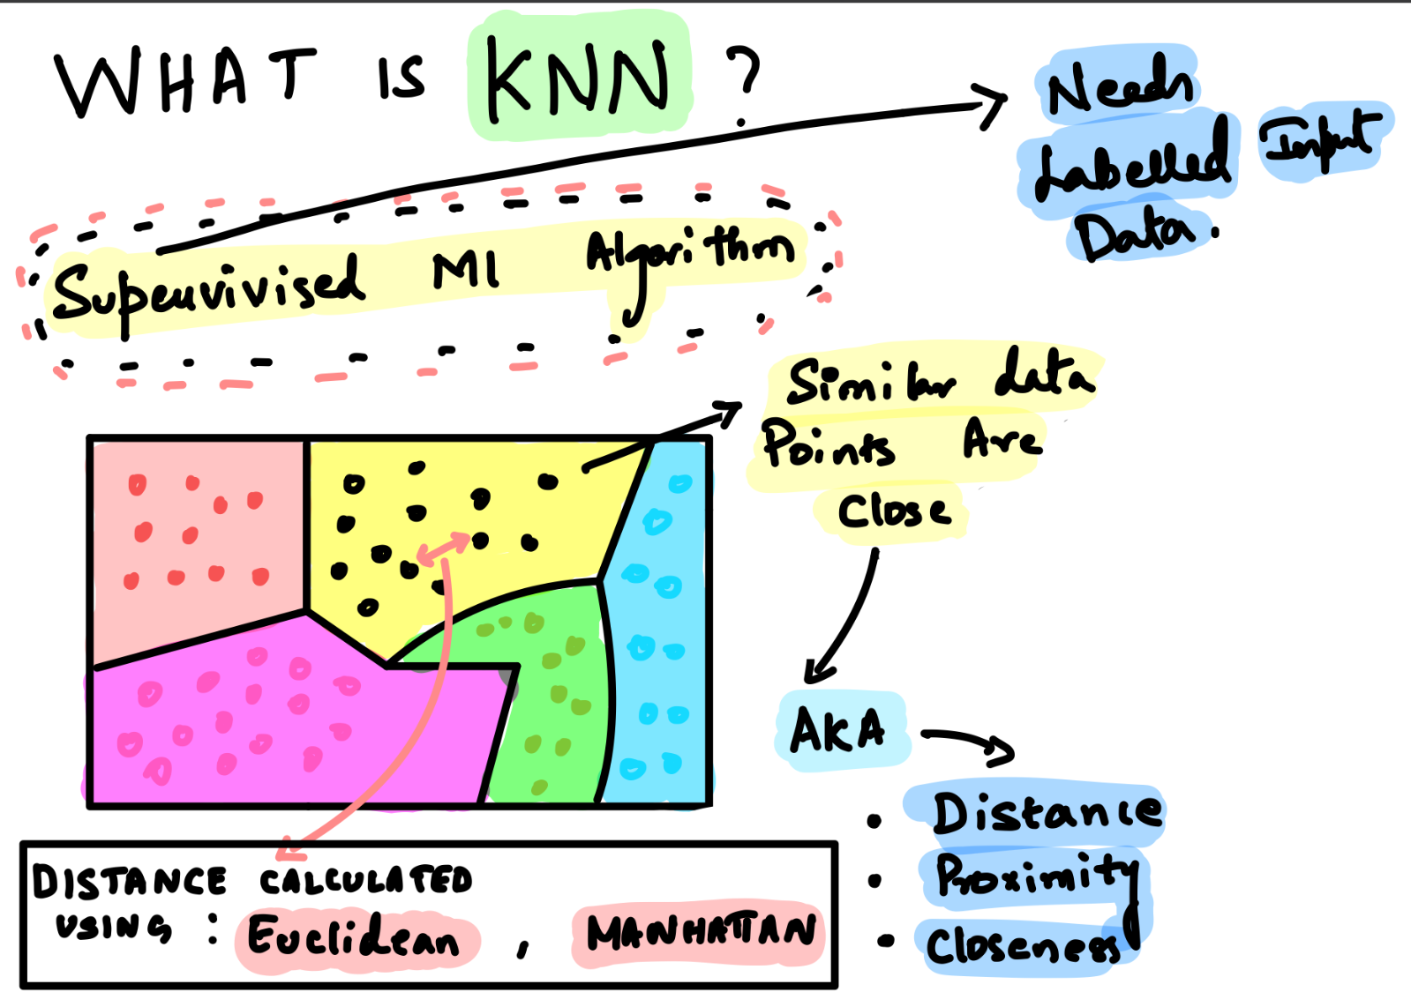
What is KNN?

Slide 3
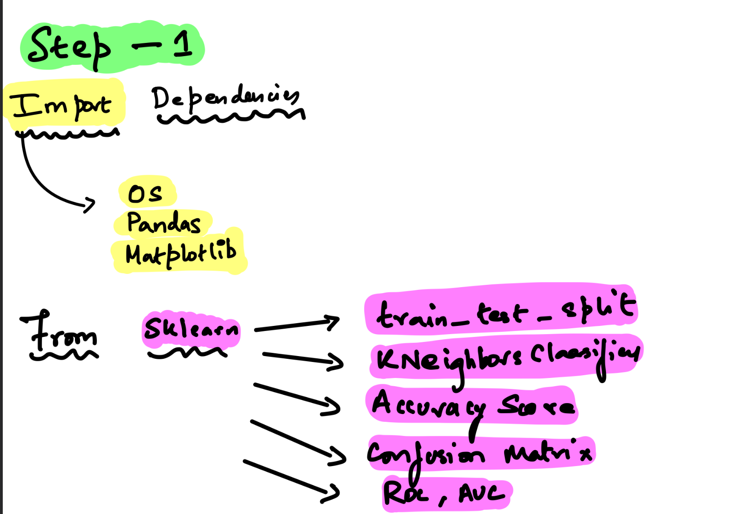
import os
import pandas as pd
import matplotlib.pyplot as plt
from sklearn.neighbors import KNeighborsClassifier
from sklearn.metrics import accuracy_score, confusion_matrix, ConfusionMatrixDisplay
from sklearn.metrics import roc_curve, auc
from sklearn import metrics

Slide 4
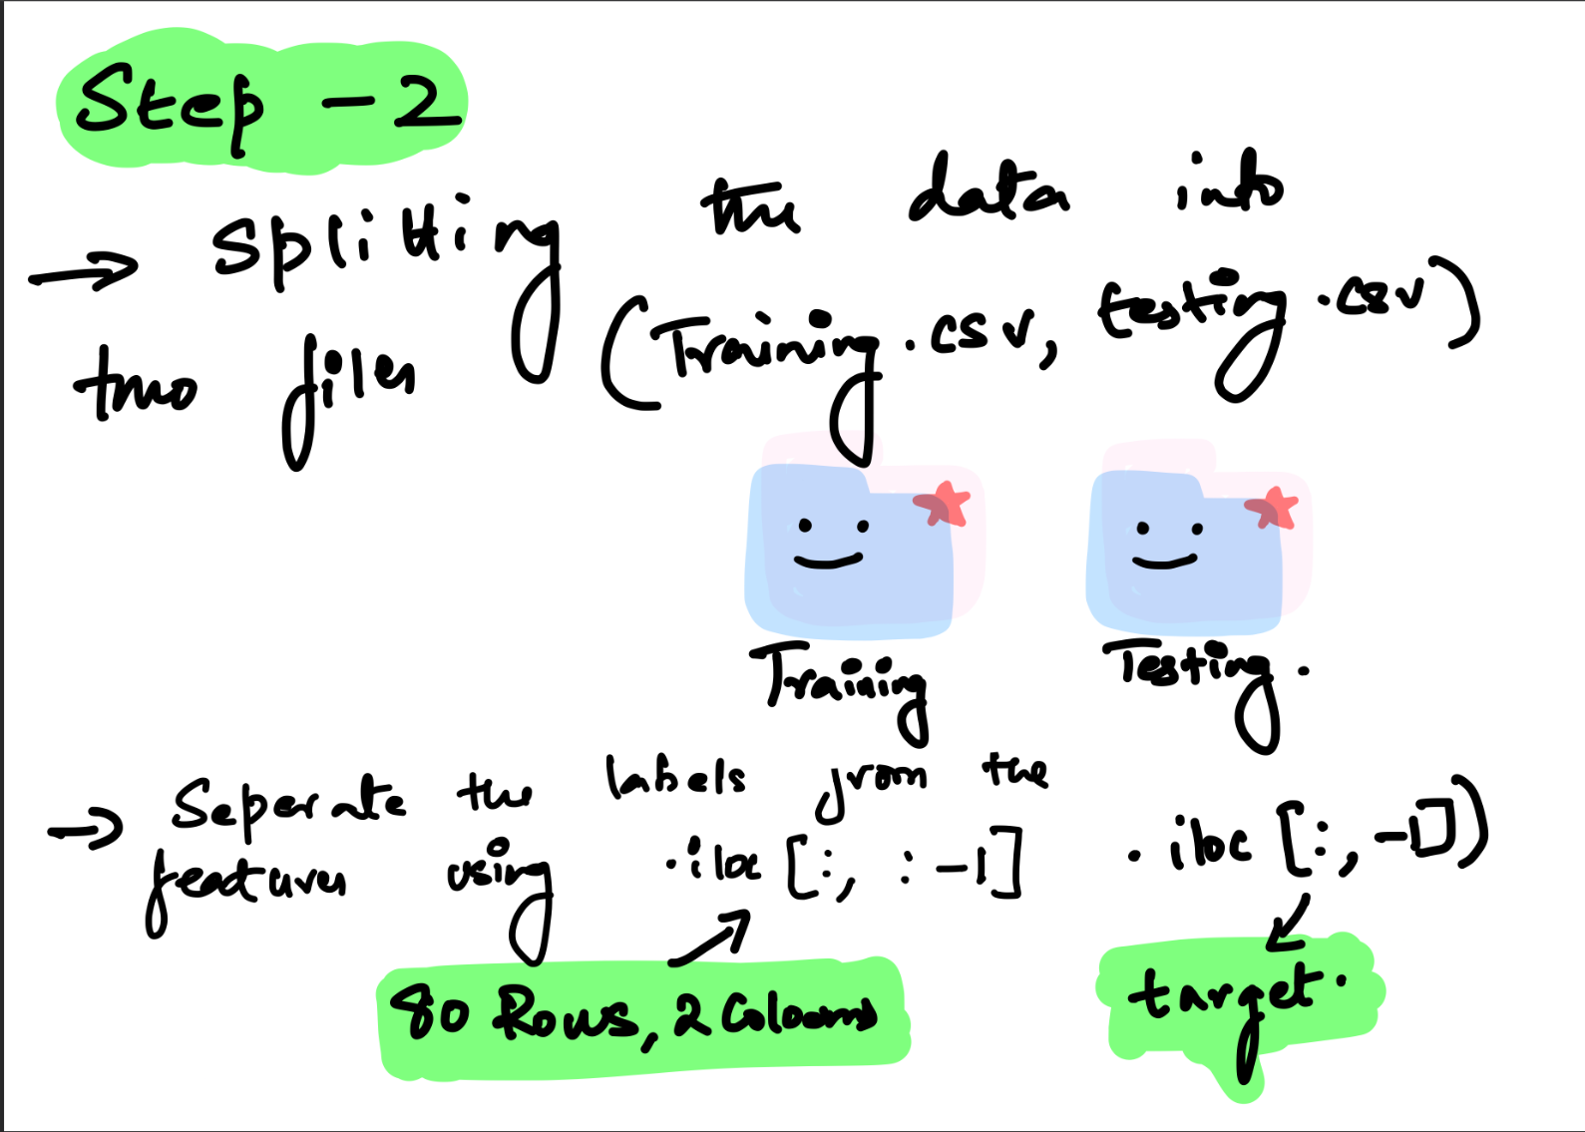
# Load dataset
training_set = pd.read_csv('trainingSet.csv', sep=',', header=None)
testing_set = pd.read_csv('testingSet.csv', sep=',', header=None)
# Separate the Label from the Features
X_train = training_set.iloc[:, :-1]
y_train = training_set.iloc[:, -1]
X_test = testing_set.iloc[:, :-1]
y_test = testing_set.iloc[:, -1]

Slide 5
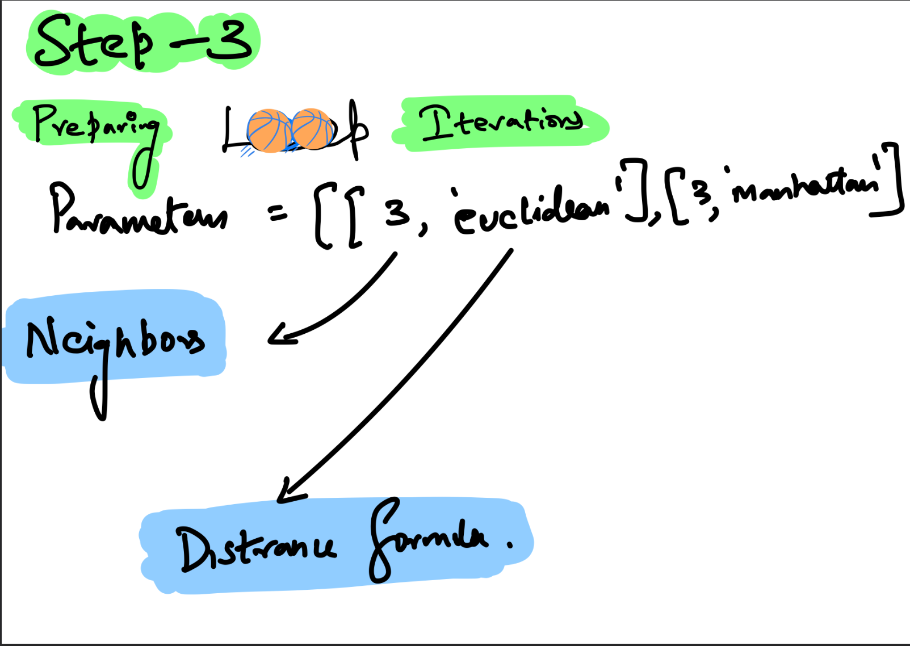
# Prepare loop iterations with model parameters
parameters = [[3, 'euclidean'], [3, 'manhattan'], [5, 'euclidean'],
[5, 'manhattan'], [7, 'euclidean'], [7, 'manhattan']]
for p in parameters:
# Print title
print(f"Results with {p[0]} Neighbors and Distance Formula {p[1]}:")
# Instantiate KNN classifier algorithm
knn = KNeighborsClassifier(n_neighbors=p[0], metric=p[1])
Notes:
Mobile devices do not have enough storage, and thus the need for the user of the devices to get extra space from services such as AWS. The solution will be finding an algorithm that can best address these issues. The main thing holding back the adoption of cloud computing is the ongoing issue of data security. This worry stems from the fact that personal information kept in public clouds is handled by for-profit service providers who might not be completely reliable.

Slide 6
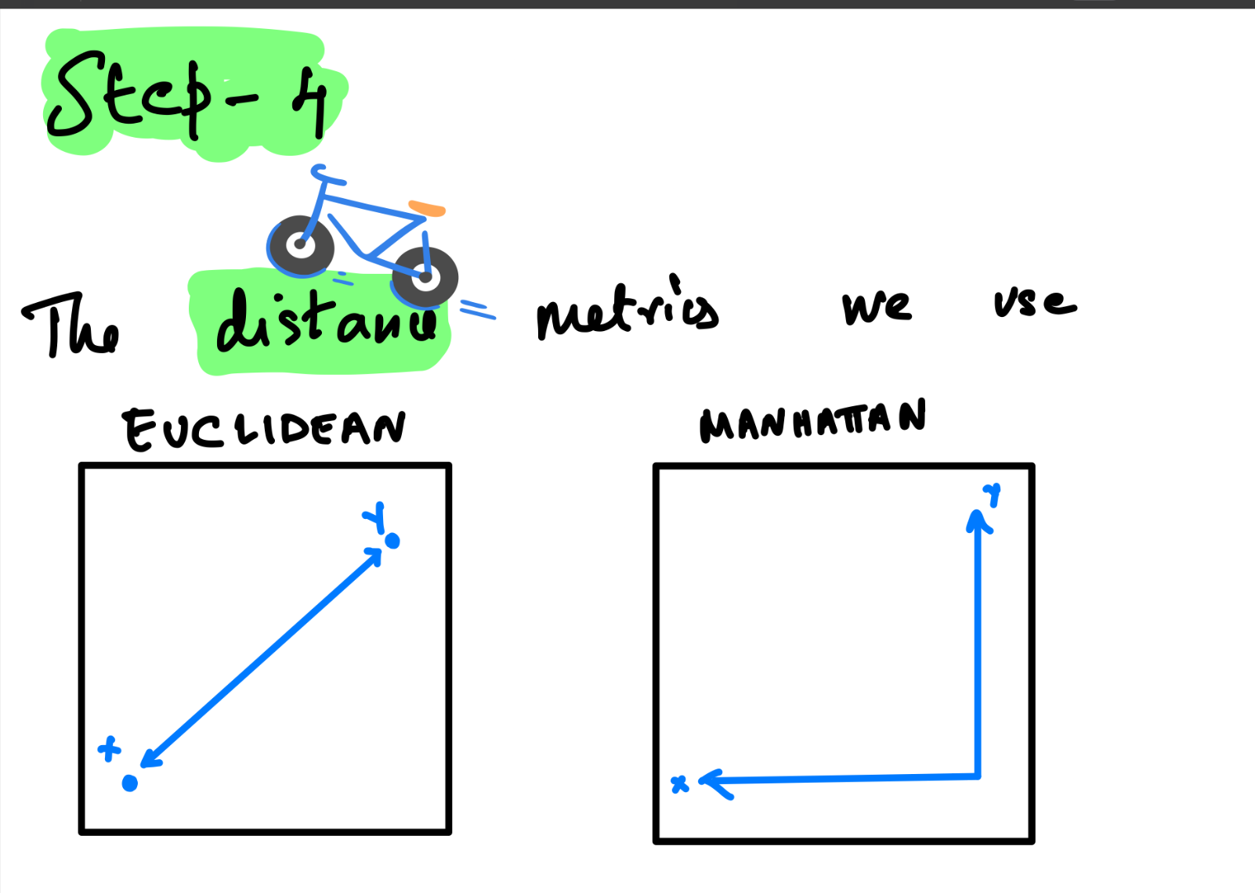

Slide 7
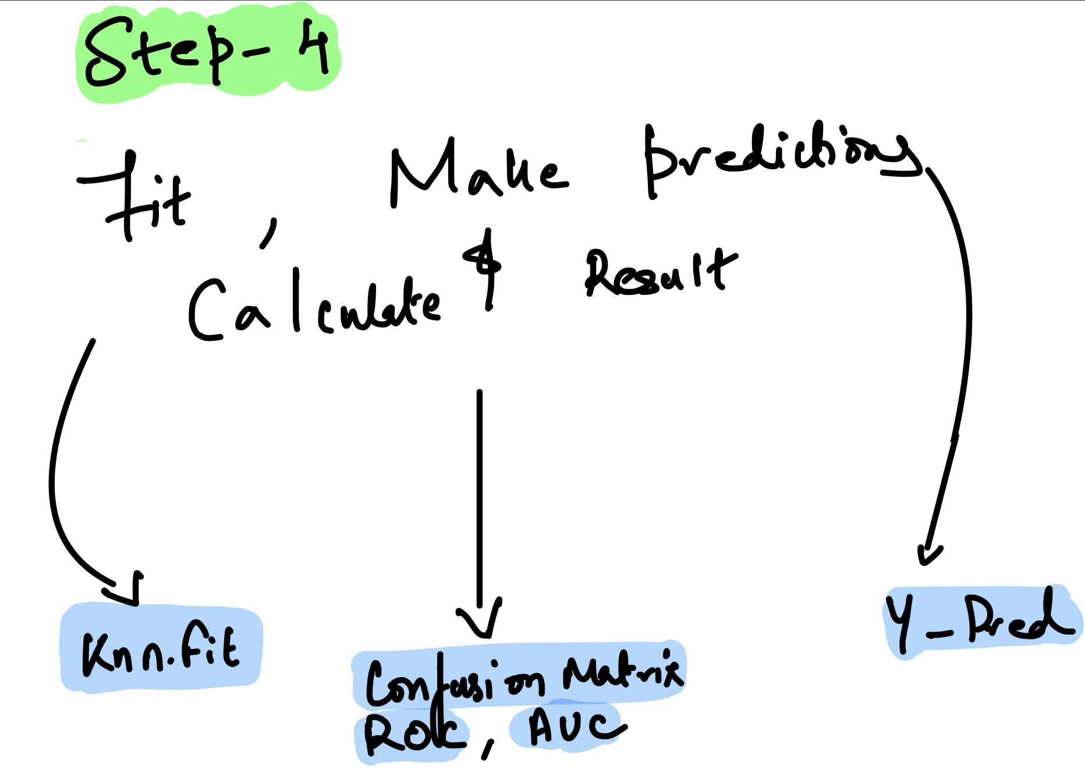

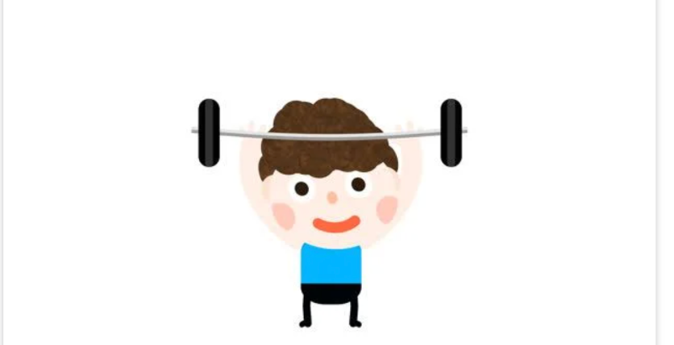
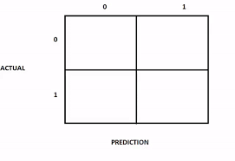
# Fit the model
knn.fit(X_train, y_train)
# Make predictions
y_pred =knn.predict(X_test)
# Calculate accuracy
accuracy= accuracy_score(y_test, y_pred)
print(f"Accuracy score: {accuracy:.2f}")

Slide 8
# Calculate confusion matrix
cm = confusion_matrix(y_test, y_pred)
print(f"Confusion Matrix: \n{cm}")
disp = ConfusionMatrixDisplay(confusion_matrix=cm)
disp.plot()
plt.show()
# Sensitivity
sensitivity = cm[0,0]/(cm[0,0]+cm[0,1])
print('Sensitivity : ', sensitivity )
# Specificity
specificity = cm[1,1]/(cm[1,0]+cm[1,1])
print('Specificity : ', specificity)
# F1-score
fscore = cm[0,0]/(cm[0,0]+0.5*(cm[1,0]+cm[0,1]))
print('F1-score : ', fscore)
# Calculate ROC curve and AUC
y_pred_proba = knn.predict_proba(X_test)[:, 1]
fpr, tpr, thresholds = roc_curve(y_test, y_pred_proba)
roc_auc = auc(fpr, tpr)
plt.plot(fpr, tpr, label=f"AUC = {roc_auc:.2f}")
plt.ylabel('True Positive Rate (Sensitivity)')
plt.xlabel('False Positive Rate (Specificity)')
plt.legend(loc='lower right')
plt.show()

Slide 9
Results
Distance | N | Sensitivity TP/(TP + FN) | Specificity TN/(TN + FN) | F1-score TP/(TP + 0.5(FP + FN)) | Accuracy (TP+ TN)/total
Euclidean | 3 | 0.9 | 0.9 | 0.9 | 0.90
Manhattan | 3 | 0.9 | 0.9 | 0.9 | 0.90
Euclidean | 5 | 0.9 | 0.9 | 0.9 | 0.90
Manhattan | 5 | 0.9 | 0.9 | 0.9 | 0.90
Euclidean | 7 | 0.9 | 0.9 | 0.9 | 0.90
Manhattan | 7 | 0.9 | 0.9 | 0.9 | 0.90

Slide 10
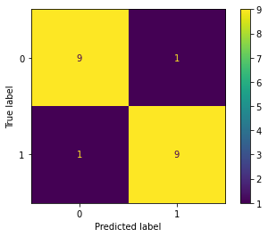
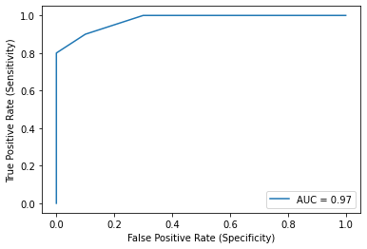
KNN – 3, Euclidean, Manhattan

Slide 11
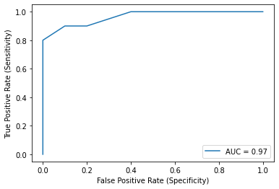
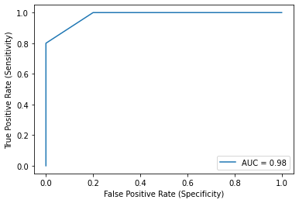
KNN – 5, Euclidean, Manhattan

Slide 12
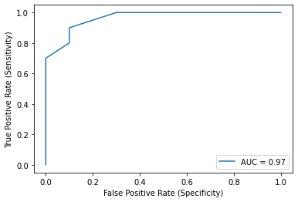
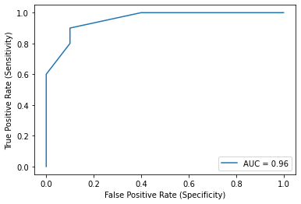
5. KNN – 7, Euclidean, Manhattan

Slide 13
Thank you.

